Slide 1

Academic Year 2025/2026
Data analyst Hydraulic structures
4th Computer engineering and networks
Presented by AIT LAHCEN Achraf
31 December 2025
Professor Ms. ELMKHALET Mouna

Slide 2
Summary
Introduction
Main Problem
Morocco And Hydraulic Structures
PCA (Principal Component Analysis)
Clustering And Predictions
CA (Correspondence Analysis)
Cybersecurity

Slide 3
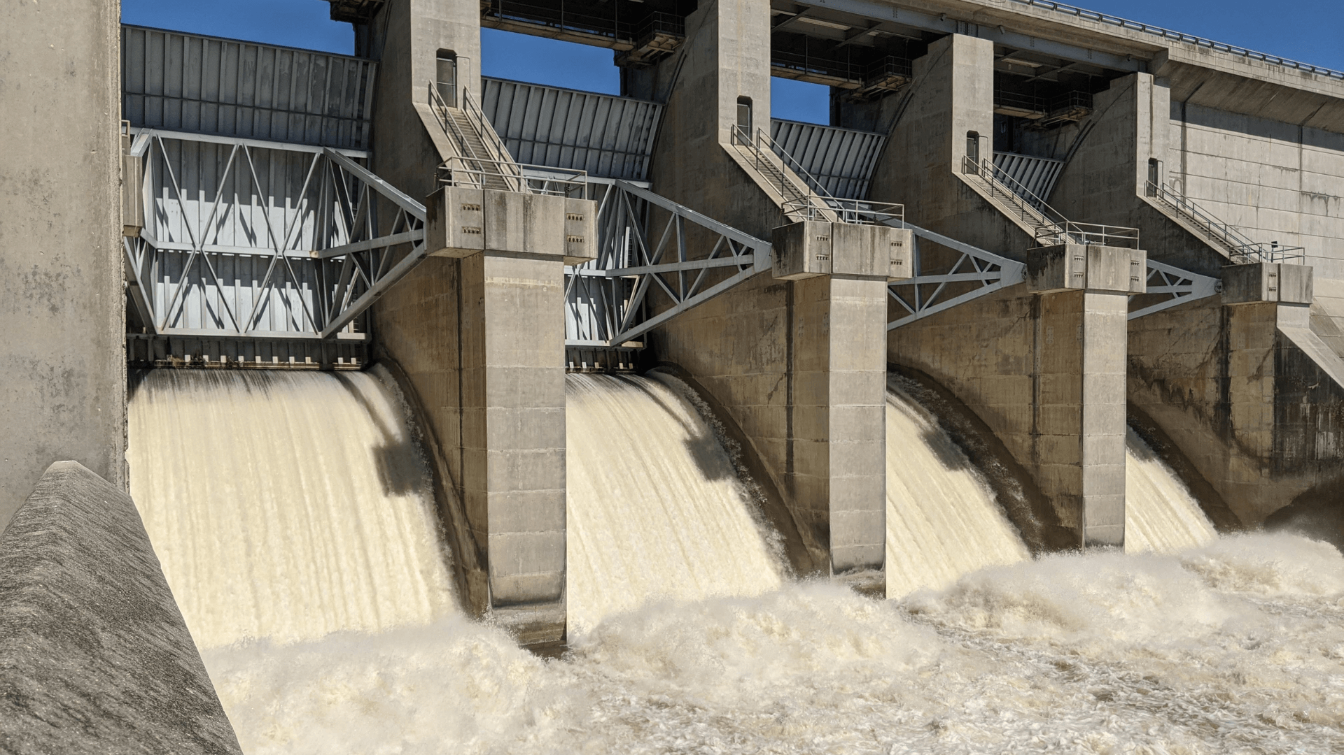
Hydraulic Structures Are Essential For Sustainable Water Management, Especially In Regions Facing Harsh Climate Conditions And Growing Demand From Agriculture, Industry, And Households. Understanding How Canals Function Hydraulically Is Necessary To Improve Efficiency, Reduce Water Losses, And Avoid Structural Failures.

Slide 4
Main problem
The main problem is that canal conditions are poorly controlled, causing strong siltation, energy losses, reduced flow capacity, and a higher risk of erosion and structural damage. This situation requires data‑driven analysis to detect the most critical canals and guide maintenance and rehabilitation actions.

Slide 5
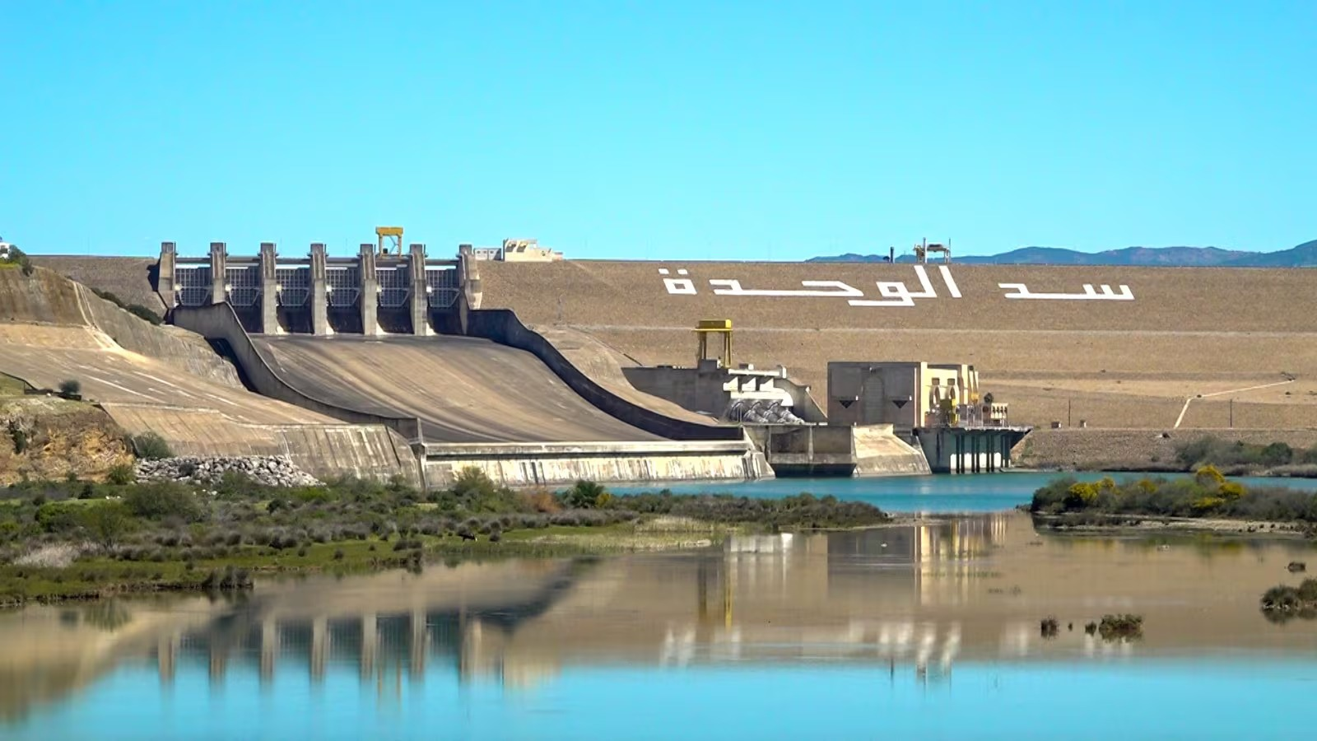
Morocco faces water scarcity and climate challenges, relying heavily on dam and irrigation networks managed by ORMVA to secure water and agricultural productivity. However, many canals suffer from siltation, high water losses, bank degradation, and control malfunctions due to poor hydraulic conditions (low velocities, unsuitable slopes, high roughness). This study analyzes 100 Moroccan canals using 8 hydraulic variables to:
Understand real-world hydraulic relationships
Classify canal types (good condition, heavily silted, undersized)
Support modernization strategies for irrigation networks
Optimizing canal performance is critical to secure irrigation, conserve water, and extend infrastructure lifespan.

Slide 6
PCA (Principal Component Analysis)

Slide 7
Variable | Mean | Std. Dev.
Flow Rate (m³/s) | 94.04 | 59.50
Water Velocity (m/s) | 2.49 | 1.47
Width (m) | 26.36 | 14.38
Depth (m) | 5.17 | 2.79
Roughness | 0.03 | 0.02
Slope (%) | 2.63 | 1.49
Water Temp (°C) | 15.79 | 6.68
Siltation (%) | 52.60 | 28.34

Slide 8
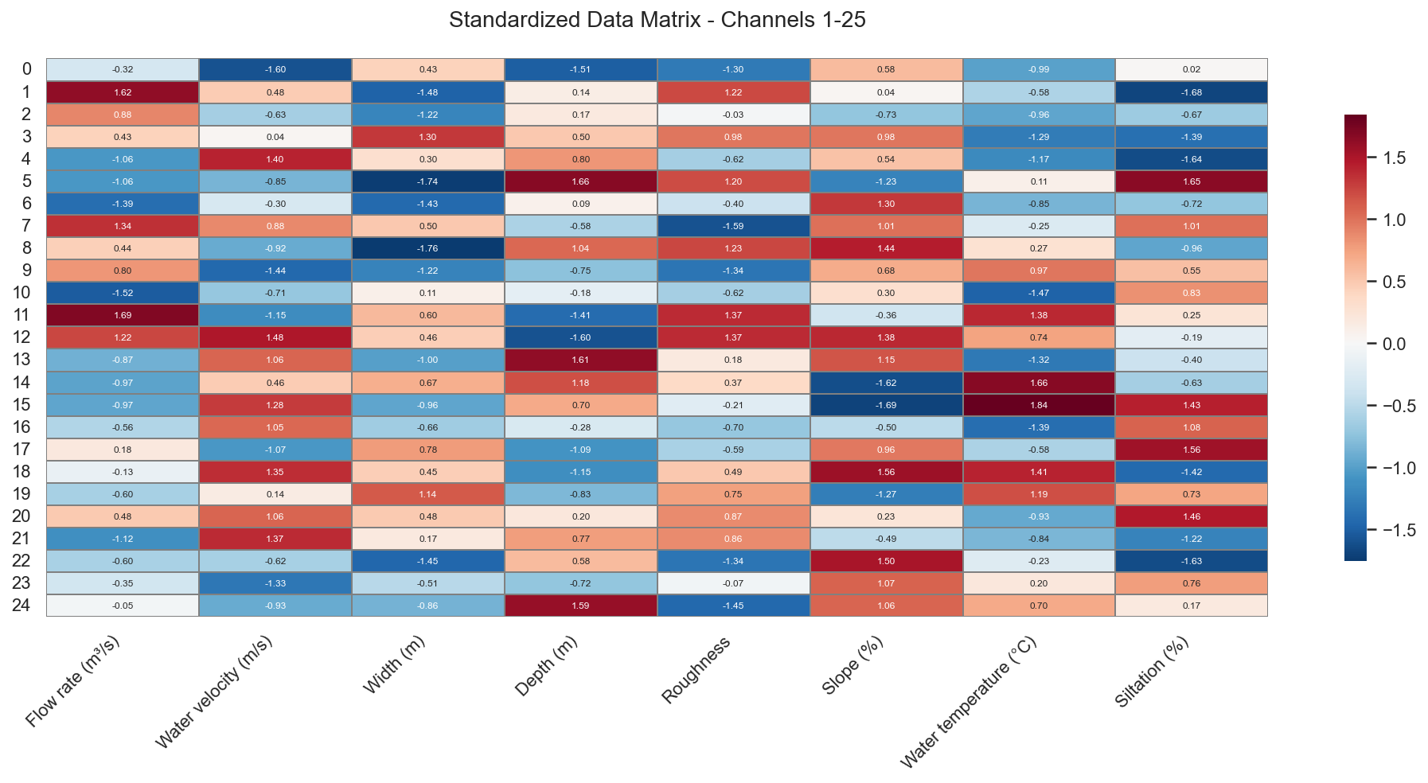
Standardized data matrix : z-scores heatmap showing how each channel deviates from average across 8 variables. Red = above average, blue = below average. Reveals extreme canal profiles and high variability, justifying PCA/clustering analysis.

Slide 9
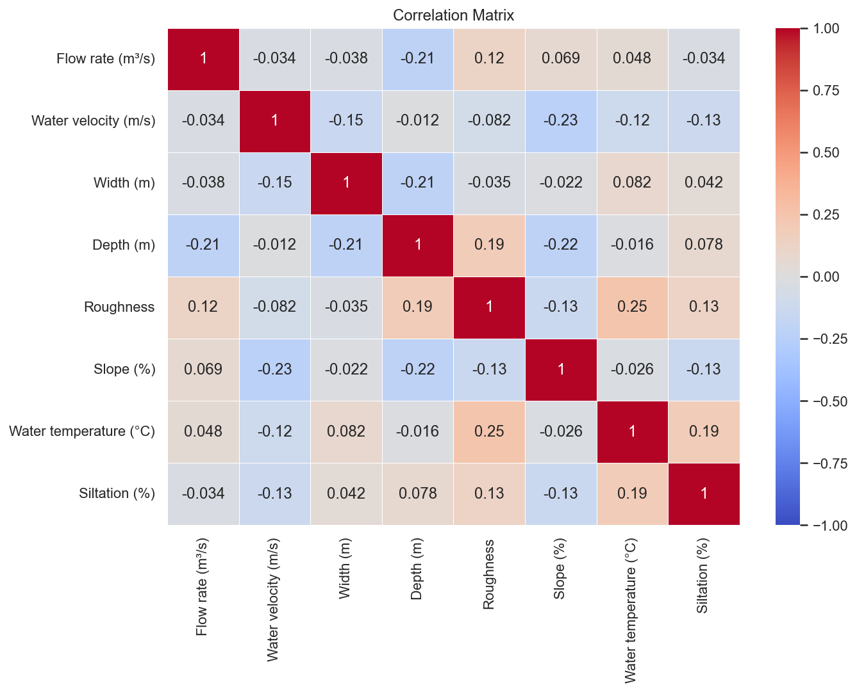
Correlation matrix: shows pairwise relationships between 8 hydraulic variables. Most correlations are weak (near 0), confirming low linear dependencies and justifying multivariate analysis (PCA). Notable: roughness-temperature (+0.25), depth-roughness (+0.19).​

Slide 10
Component 1: 1.5686 | Explained inertia: 0.1941 (19.41%) - Cumulative: 19.41%
Component 2: 1.4662 | Explained inertia: 0.1814 (18.14%) - Cumulative: 37.56%
Component 3: 1.1356 | Explained inertia: 0.1405 (14.05%) - Cumulative: 51.61%
Component 4: 1.0782 | Explained inertia: 0.1334 (13.34%) - Cumulative: 64.95%
Component 5: 0.8548 | Explained inertia: 0.1058 (10.58%) - Cumulative: 75.53%
Component 6: 0.8140 | Explained inertia: 0.1007 (10.07%) - Cumulative: 85.60%
Component 7: 0.6263 | Explained inertia: 0.0775 (7.75%) - Cumulative: 93.35%
Component 8: 0.5372 | Explained inertia: 0.0665 (6.65%) - Cumulative: 100.00%
PCA Eigenvalues: first 4 explain 65%. No single dominant factor—multifactorial hydraulic behavior requires multiple dimensions for full analysis.

Slide 11
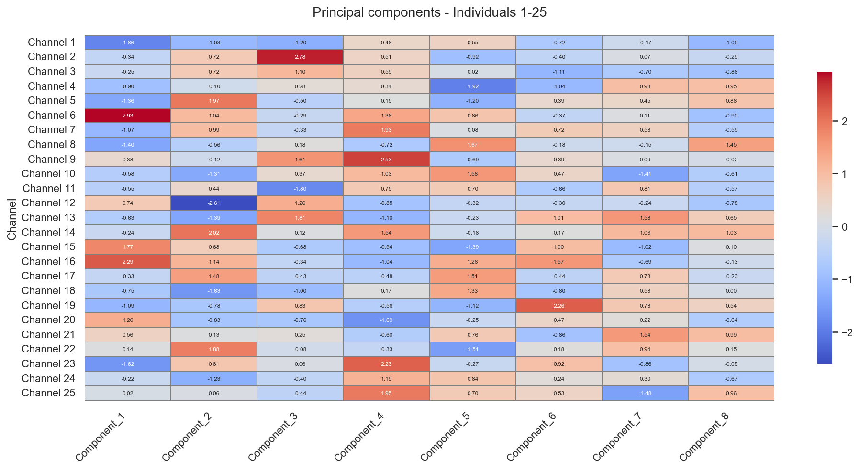
PCA scores heatmap : shows each channel's position on 8 principal components. Red = high scores, blue = low scores. Reveals atypical canal profiles and which channels drive the main variability patterns.

Slide 12
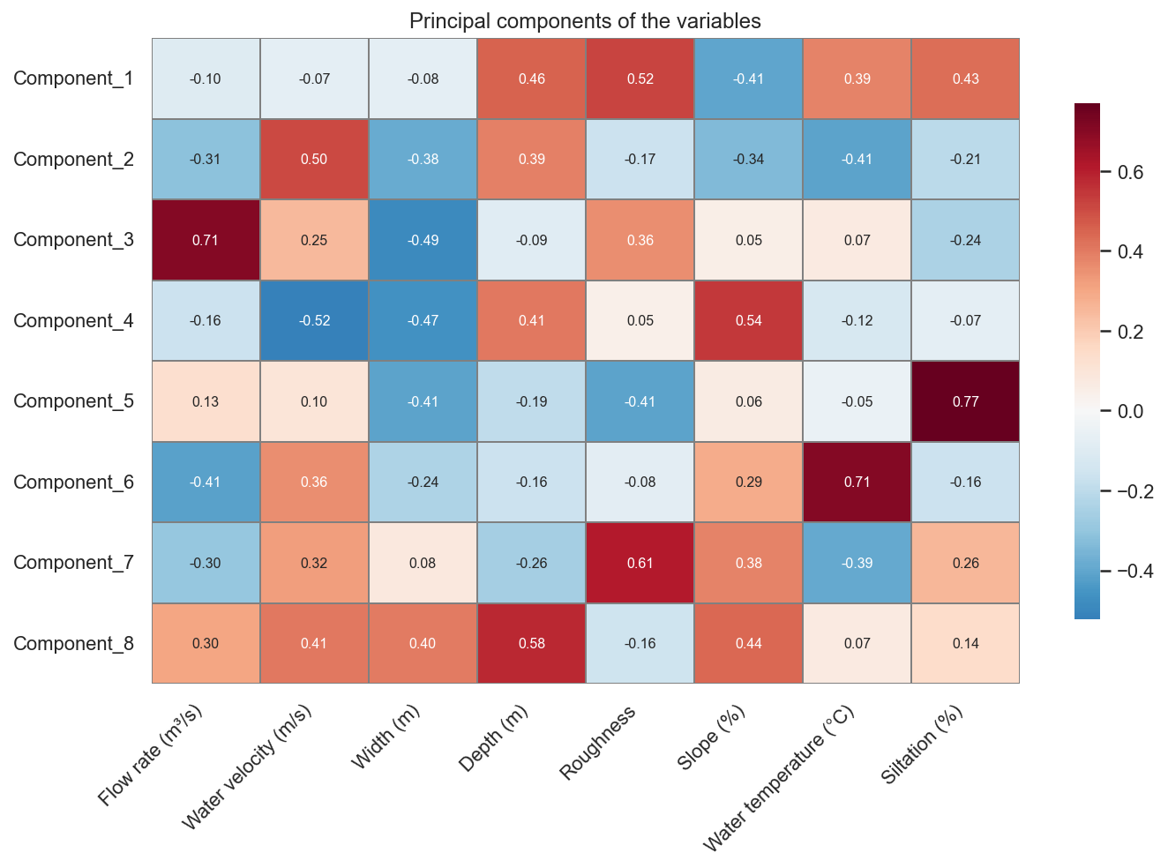
PCA loadings heatmap (variables): shows how each of the 8 variables contributes to the 8 principal components. Red = strong positive loading, blue = strong negative loading. Highlights key drivers: component 5 dominated by siltation (0.77), component 6 by temperature (0.71).

Slide 13
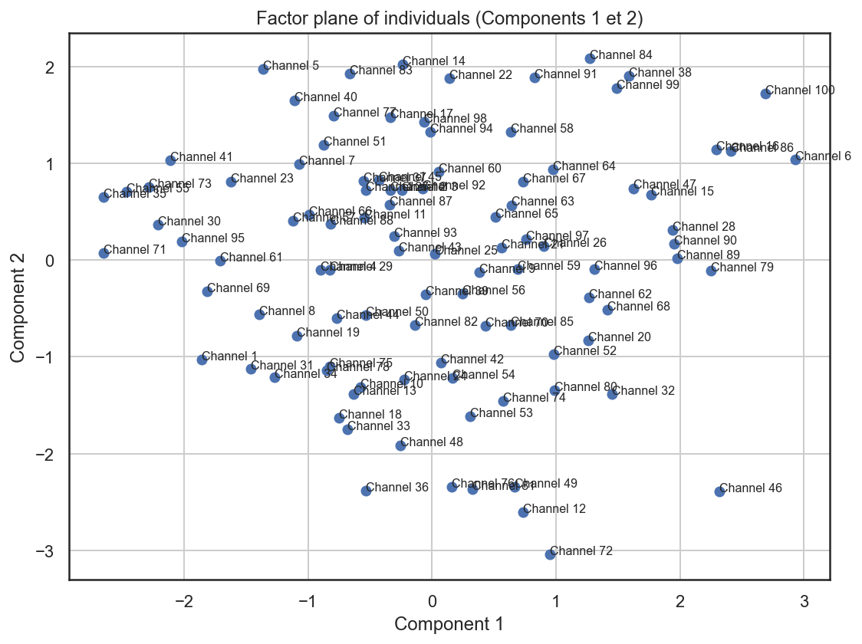

Slide 14
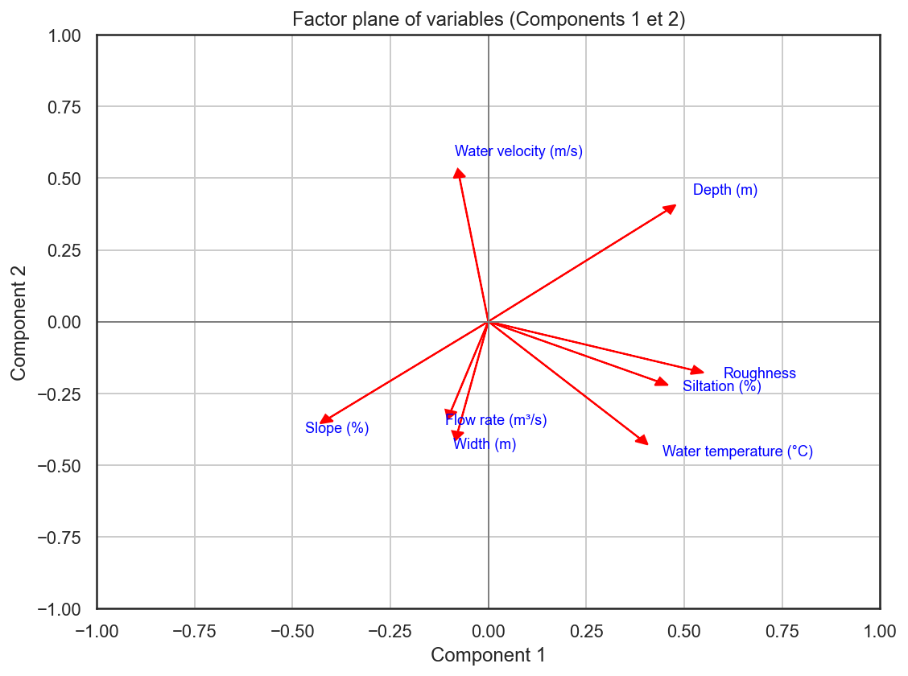

Slide 15
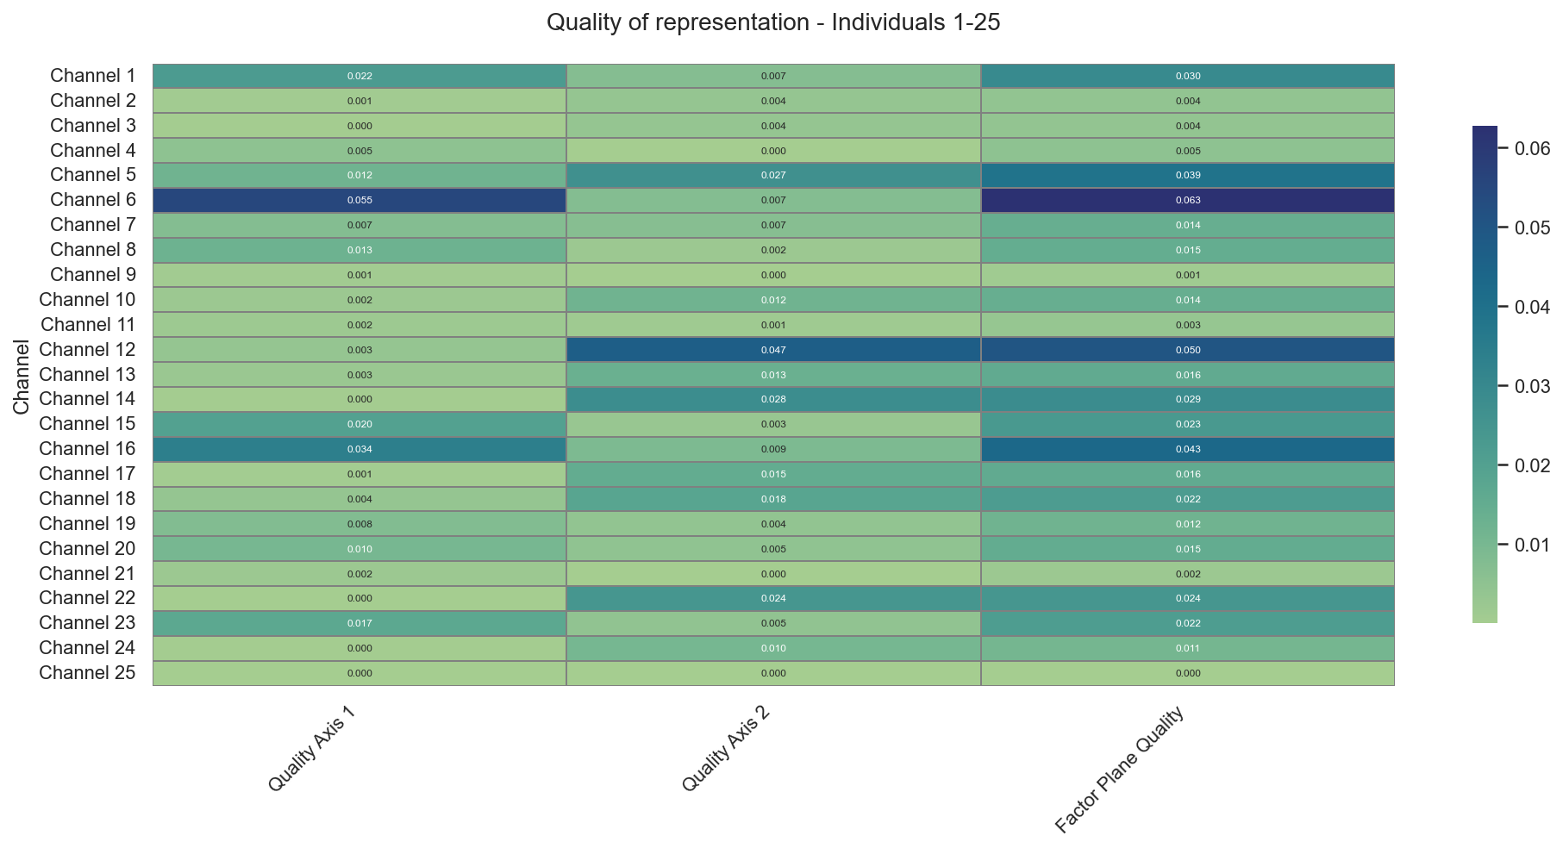
Quality of representation (channels 1-25): shows how well each channel is represented on PCA axis 1, axis 2, and factor plane (1-2). Darker colors = better representation. Identifies channels most/least well-described by the first two axes.

Slide 16
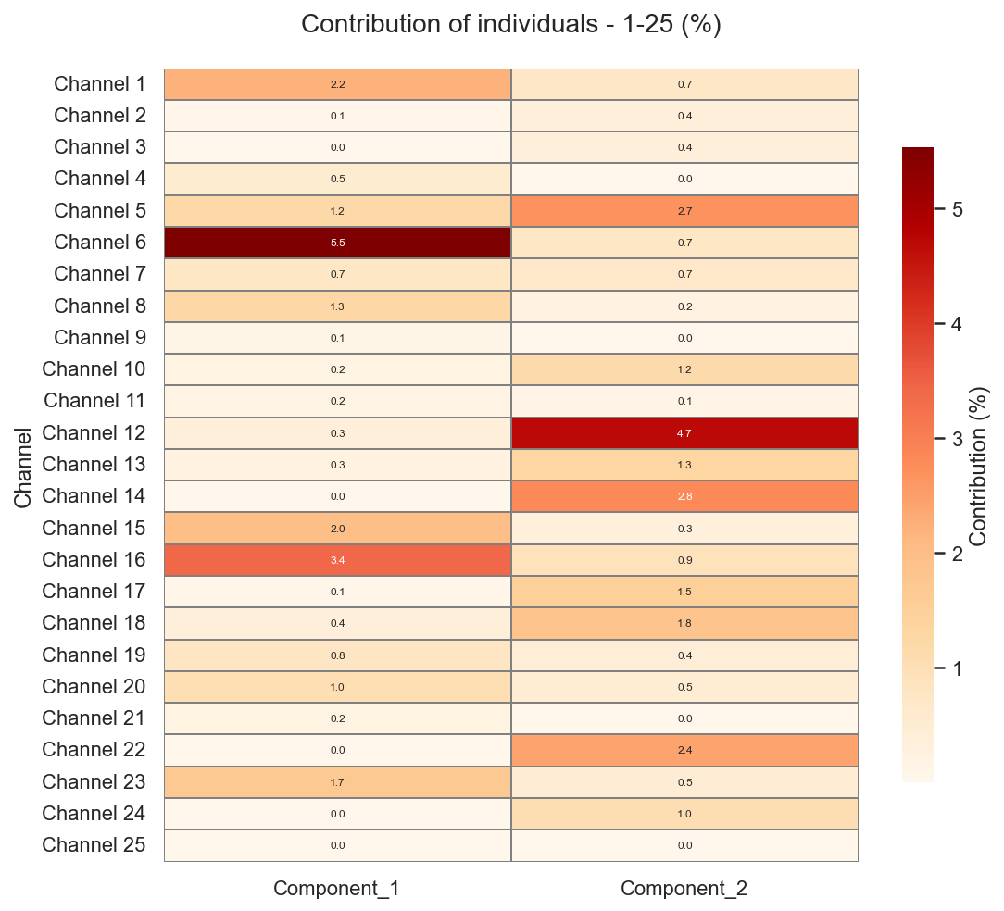
Contribution of individuals (channels 1-25): shows each channel's contribution (%) to components 1 and 2. Darker red = higher influence. Channels 6 (5.2% on comp1), channel 11 (4.7% on comp2) drive the main PCA patterns most strongly.

Slide 17
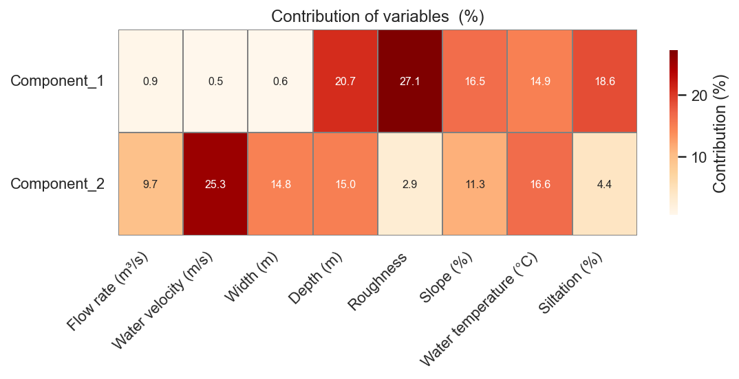
Contribution of variables (%): shows each variable's influence on components 1-2. Comp1: roughness (27%) and depth (20%) dominate. Comp2: width (25%) key drivers. Reveals main factors structuring hydraulic variability.

Slide 18
Clustering and predictions

Slide 19
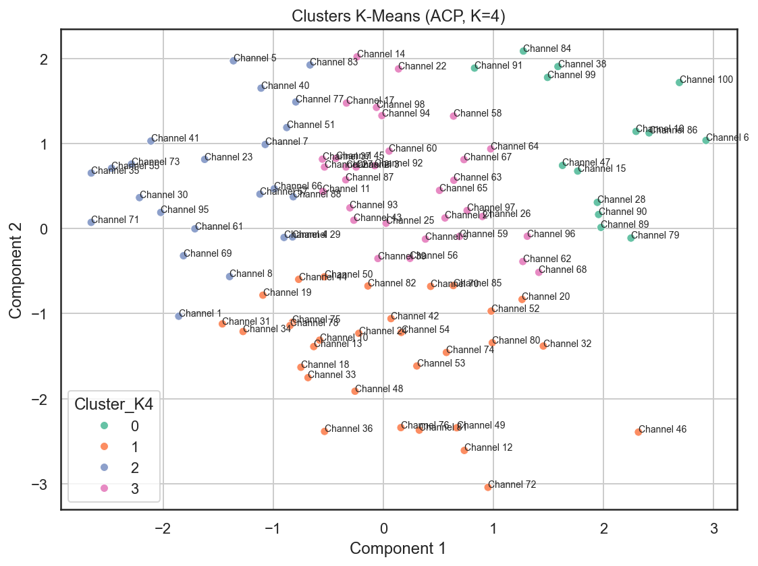

Slide 20
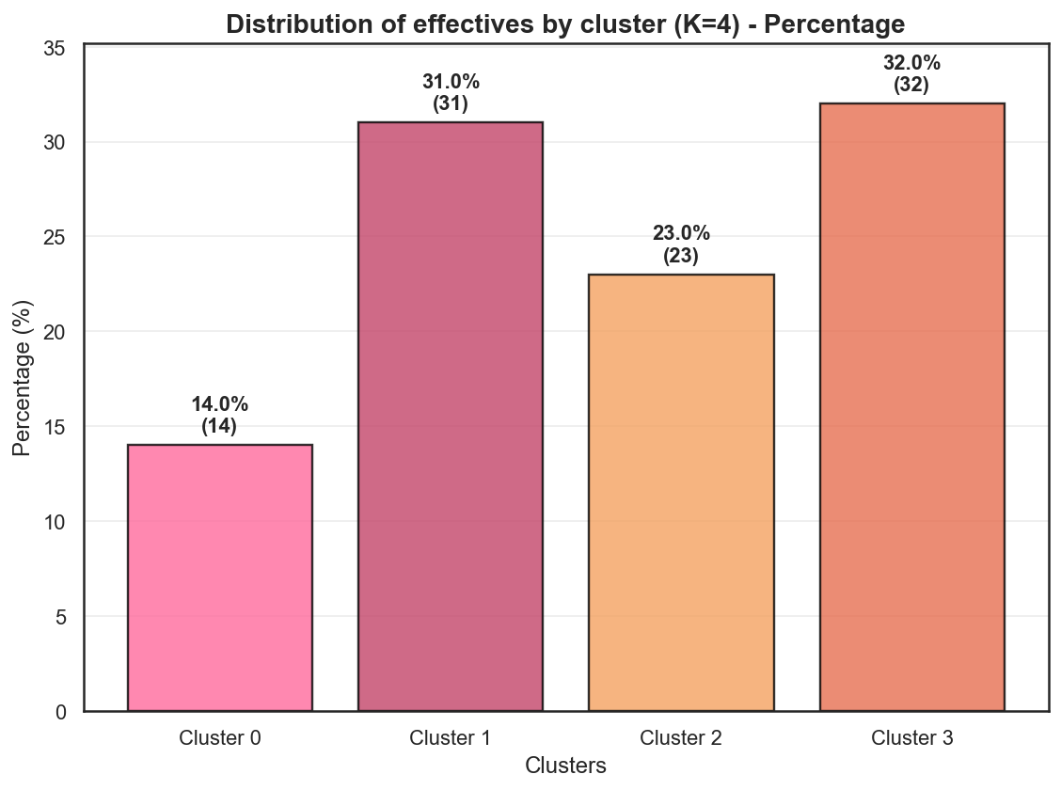

Slide 21
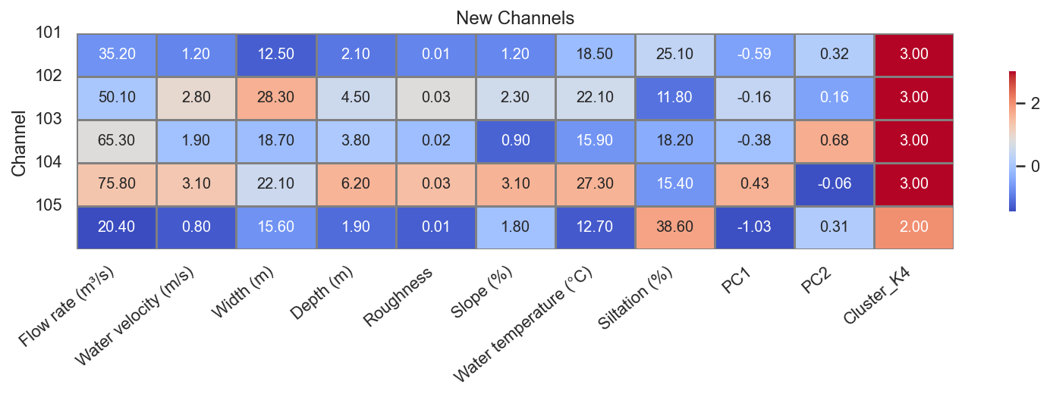

Slide 22
CA (Correspondence Analysis)

Slide 23
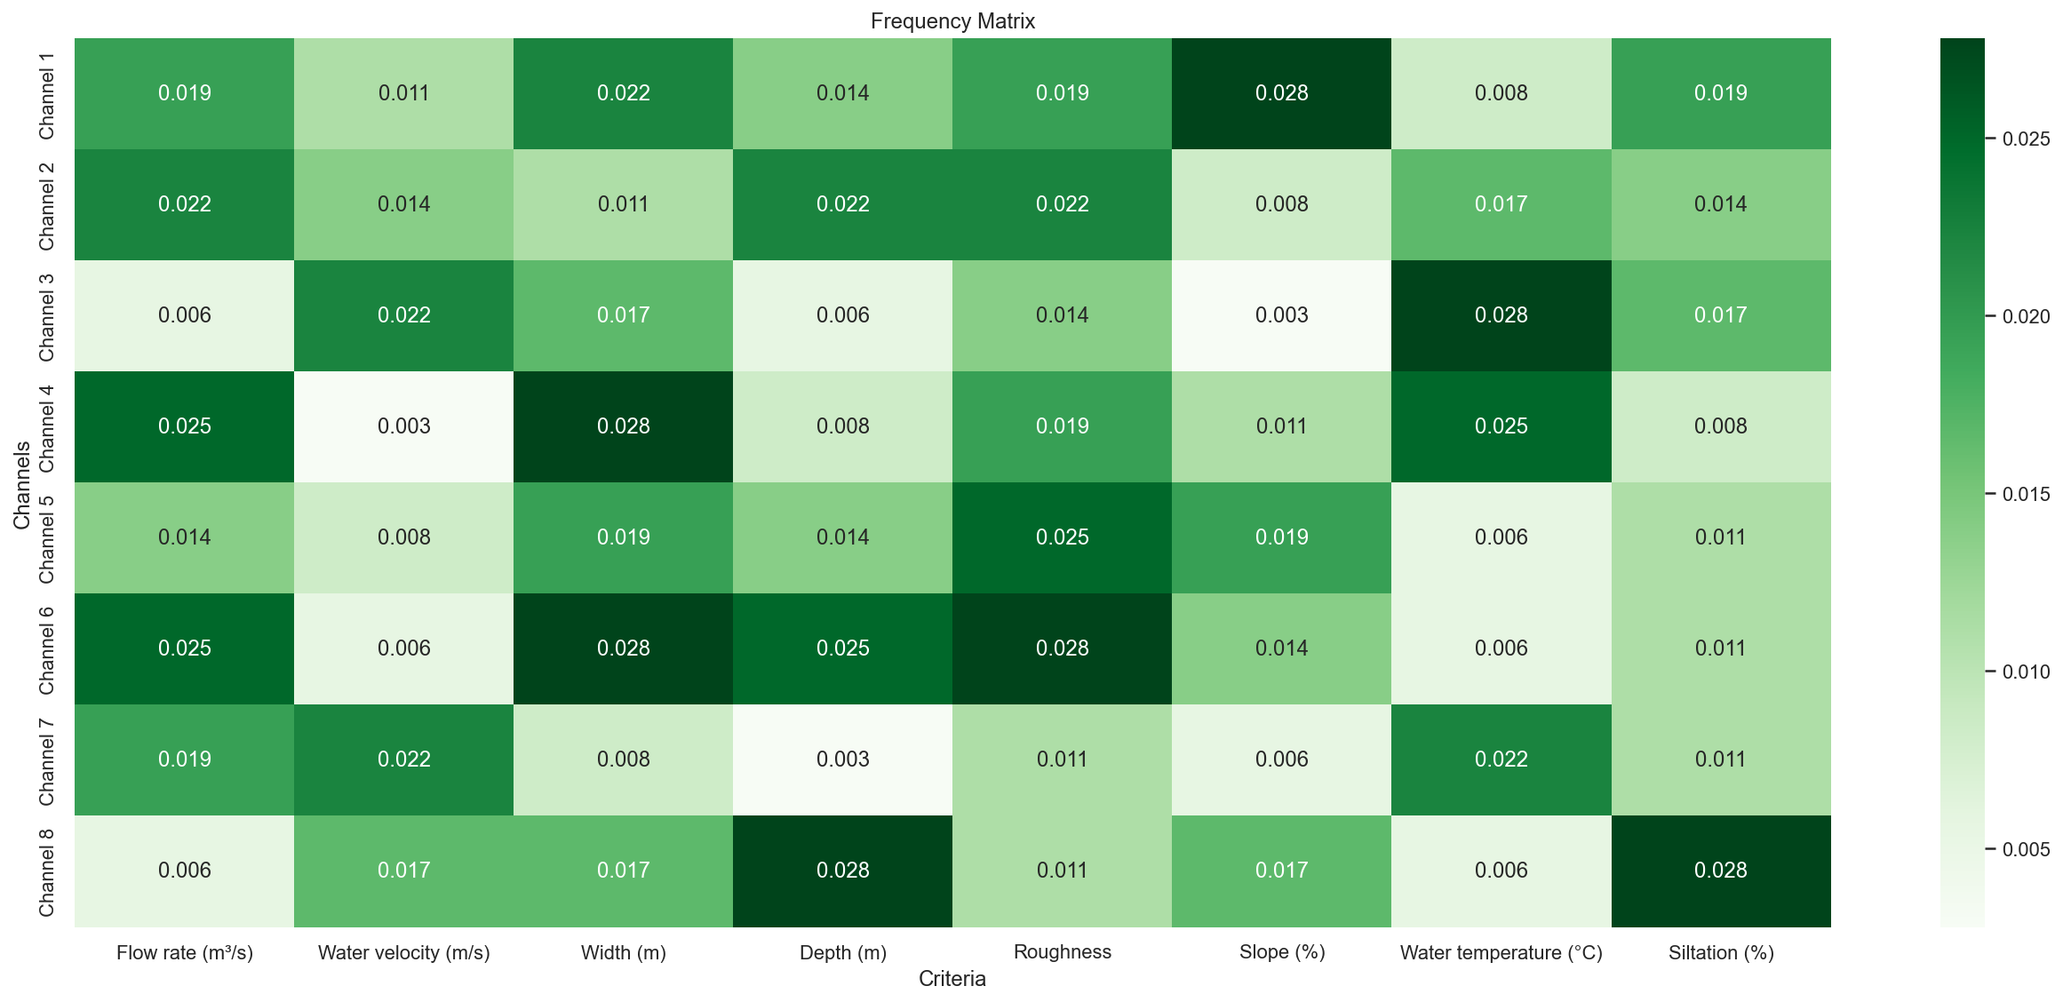
Frequency matrix P (CA): shows relative frequencies of channels across hydraulic criteria. Darker green = higher frequency. Used in correspondence analysis to study associations between channel types and hydraulic characteristics.

Slide 24
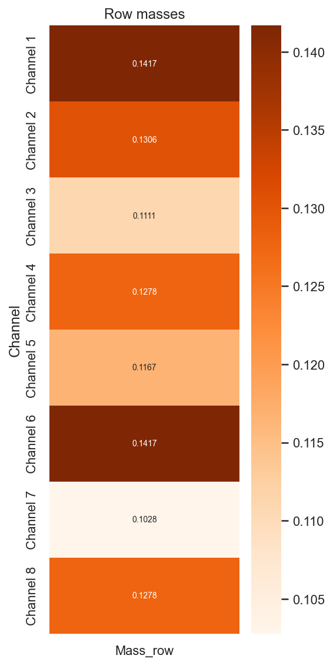
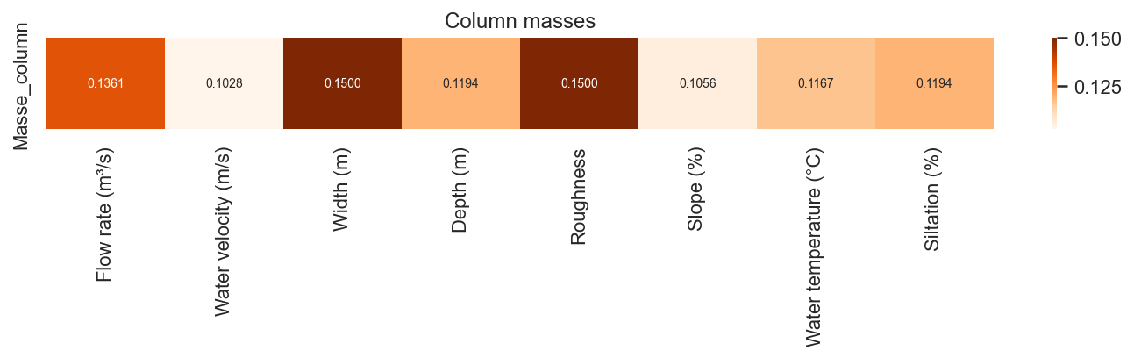
Row & column masses (CA): shows relative weights of channels (rows) and criteria (columns) in the contingency table. Darker colors = higher mass. Roughness and width have highest column masses (~0.15); channels balanced. Essential for CA axis construction.

Slide 25
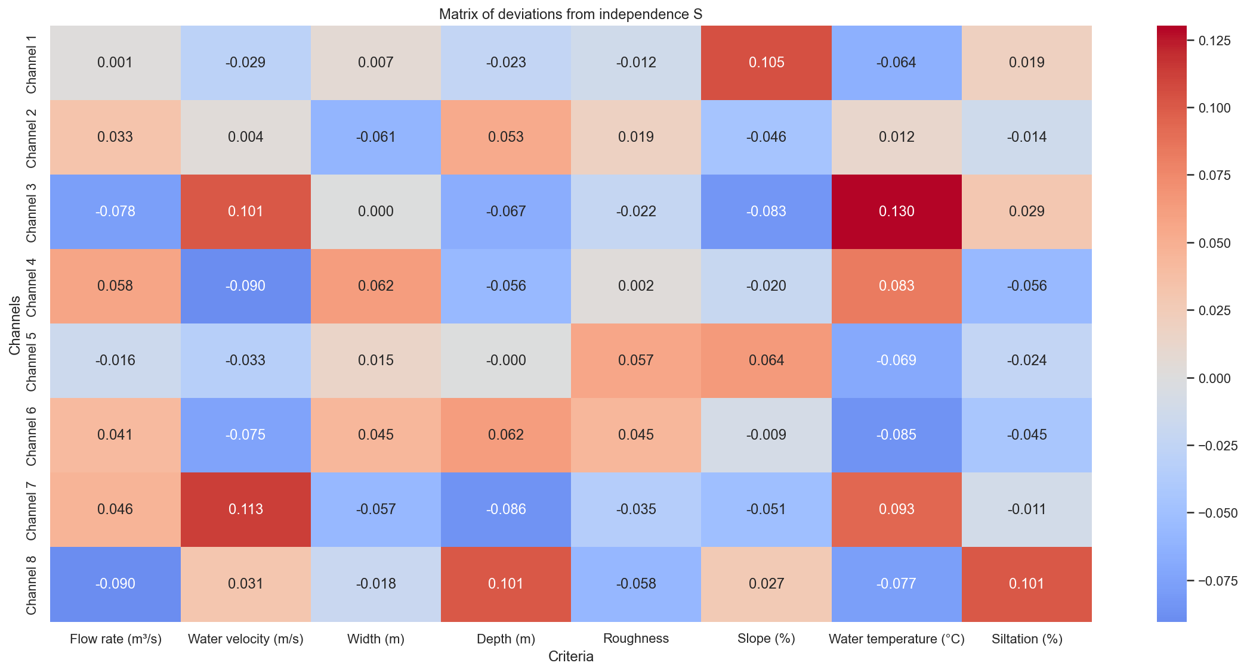
Matrix of deviations from independence S (CA): shows differences between observed and expected frequencies under independence assumption. Red = positive deviations (channels more associated with criteria than expected), blue = negative. Reveals significant associations for CA

Slide 26
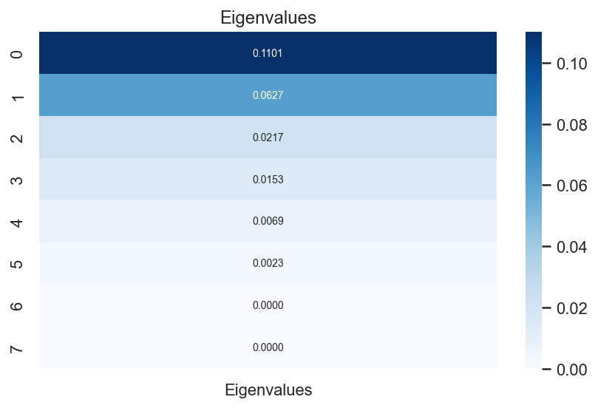
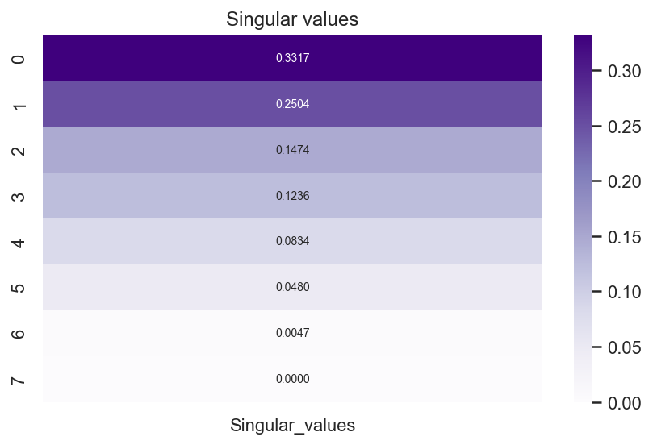
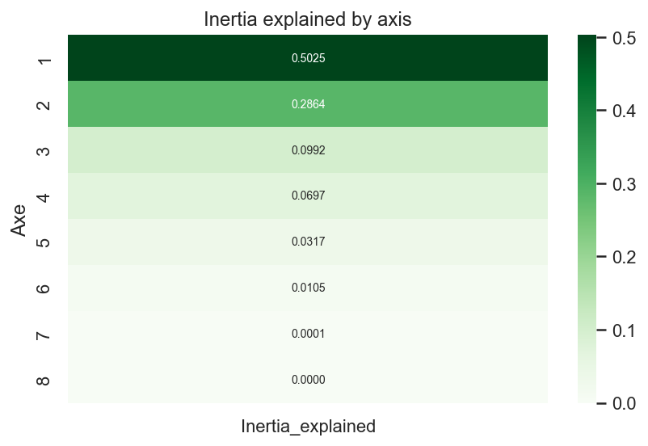

Slide 27
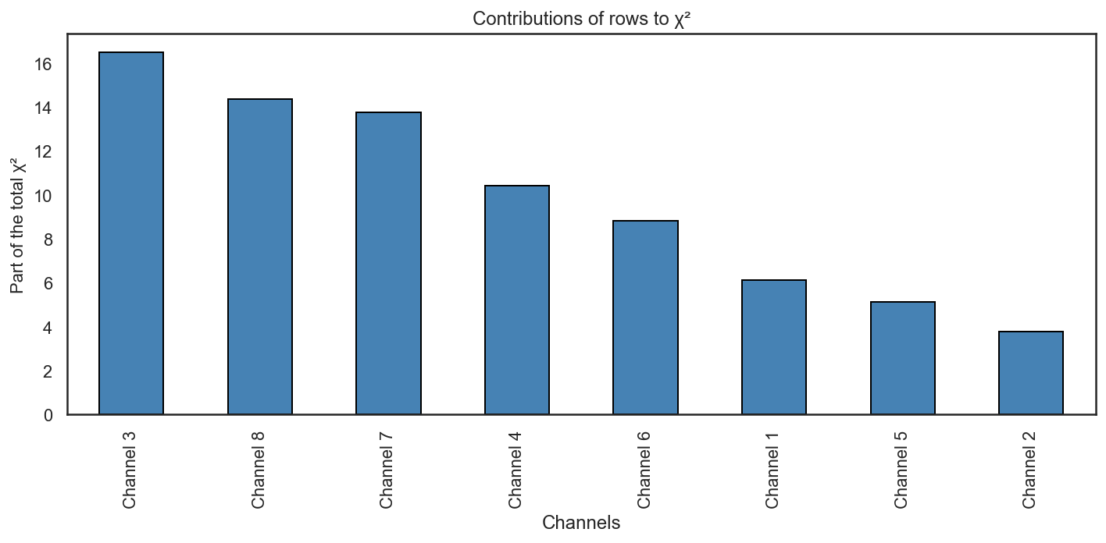
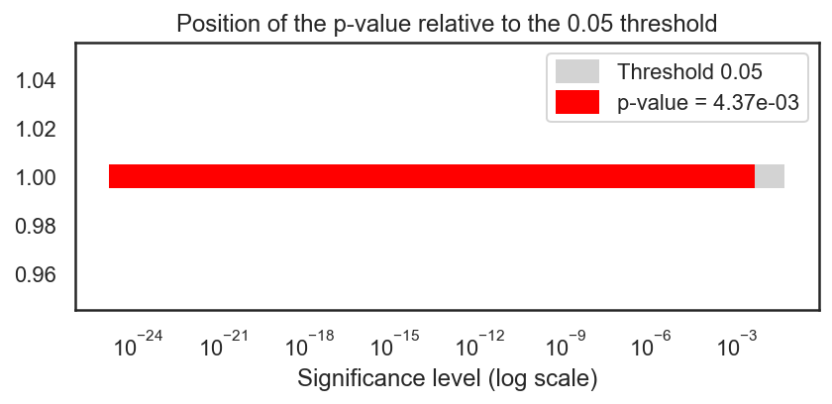
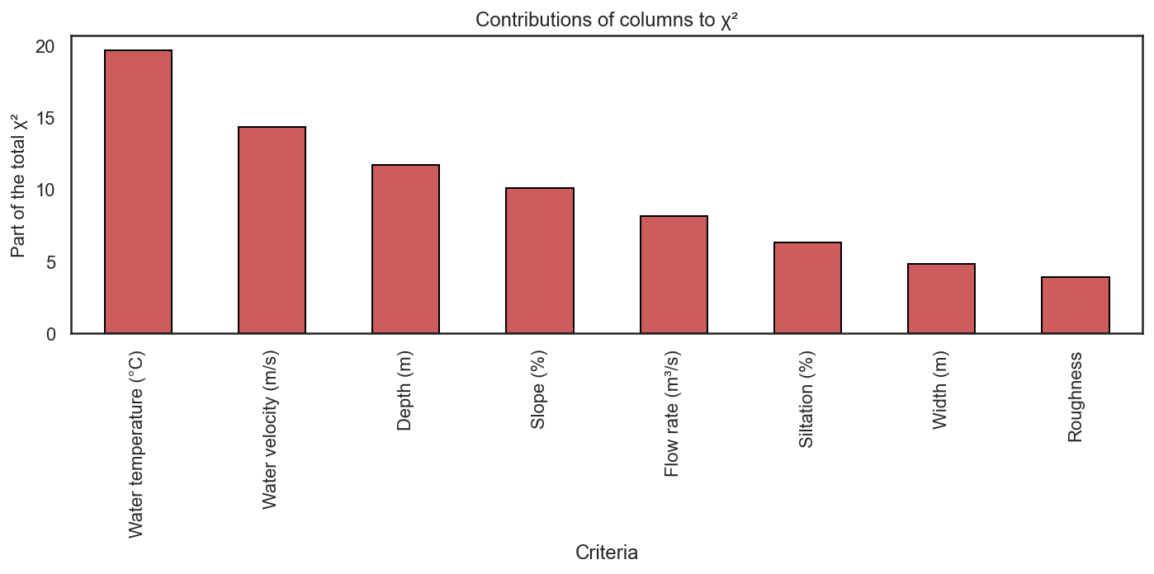
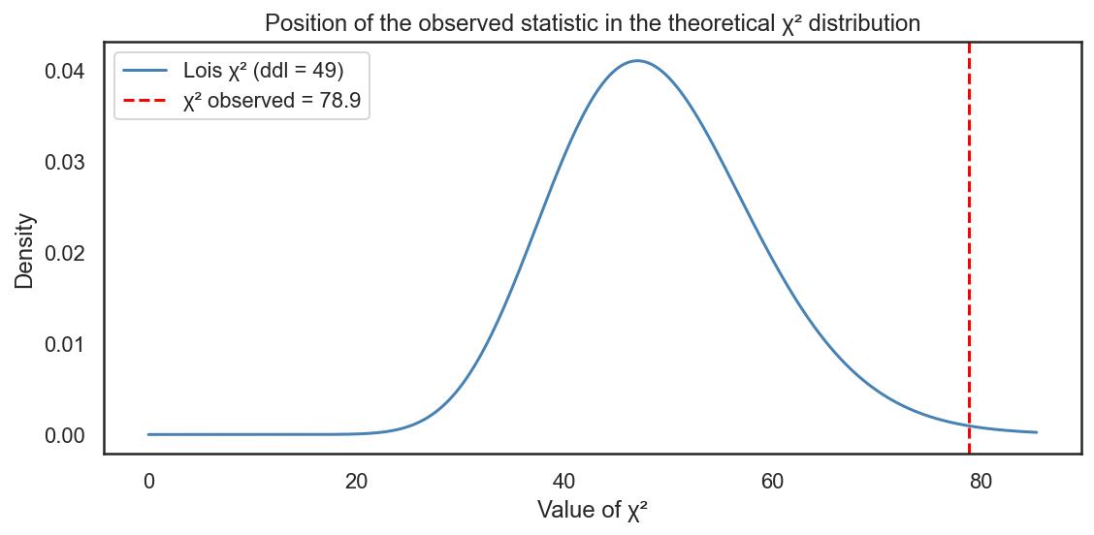

Slide 28
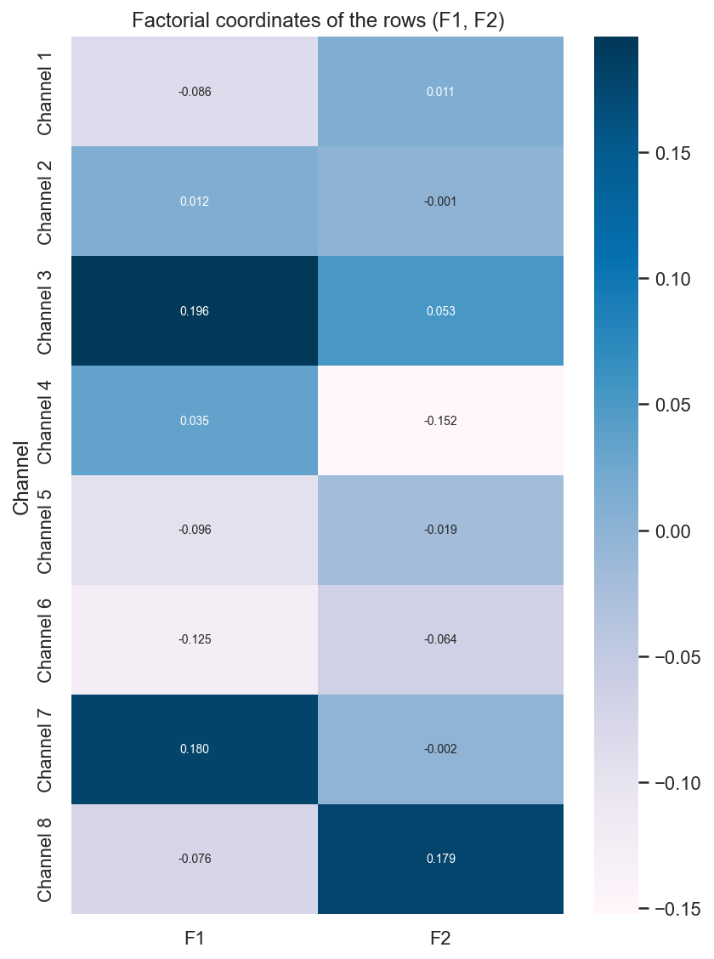
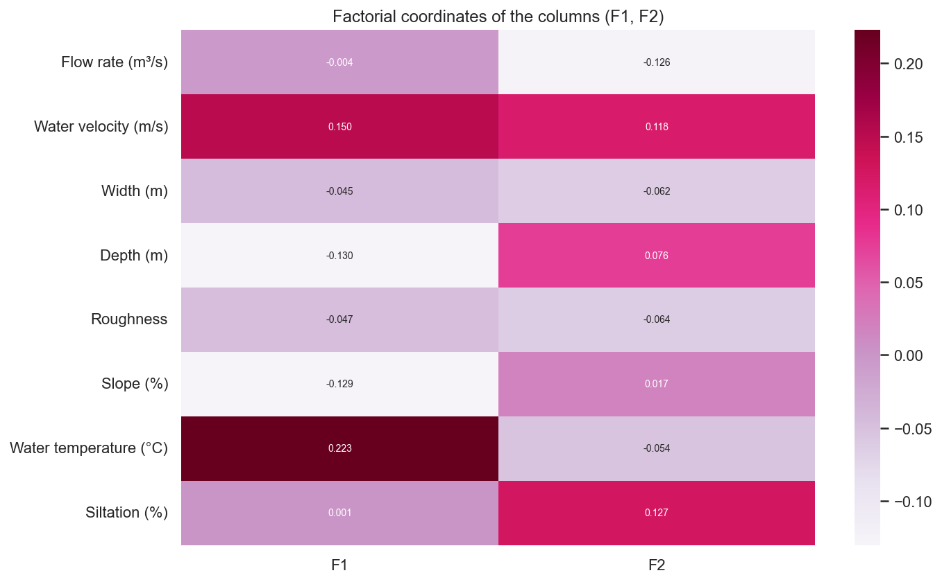

Slide 29
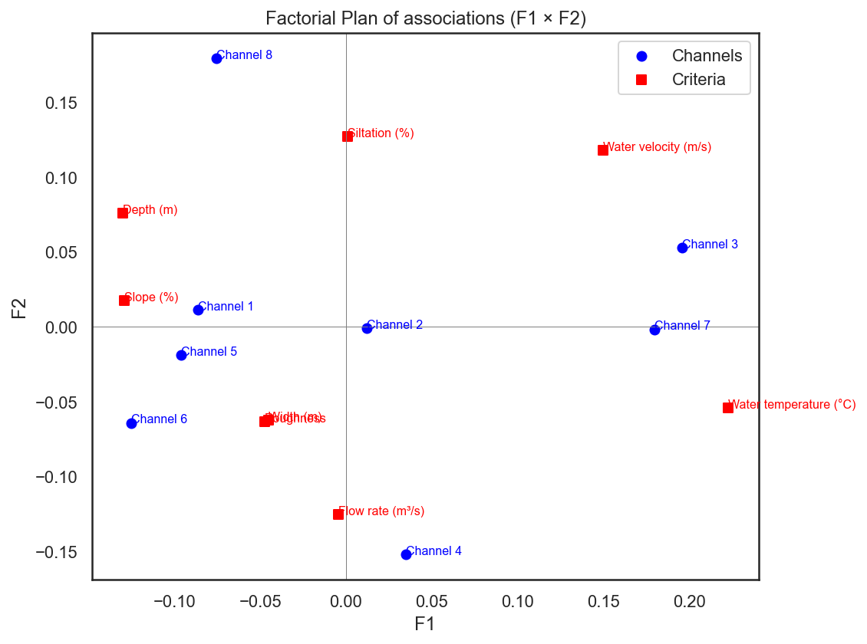

Slide 30
Cybersecurity

Slide 31
Variable | Description
SCADA Alerts | Security alerts (unauthorized access, sensor/PLC anomalies) [High = targeted system]
DDoS Attacks | Malicious traffic spikes disrupting SCADA networks [High = saturated links]
Command Latency | Delays in control commands (valves, flow settings) [High = operational risk]
Overall Risk | Composite score of alerts + attacks + latency [High = priority for security]

Slide 32
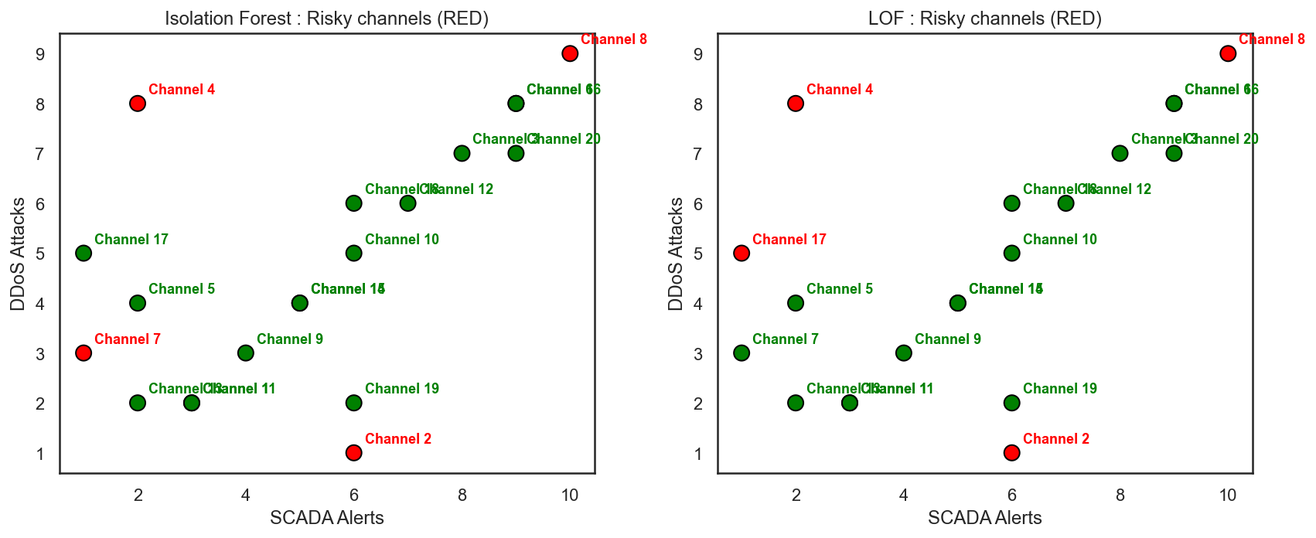
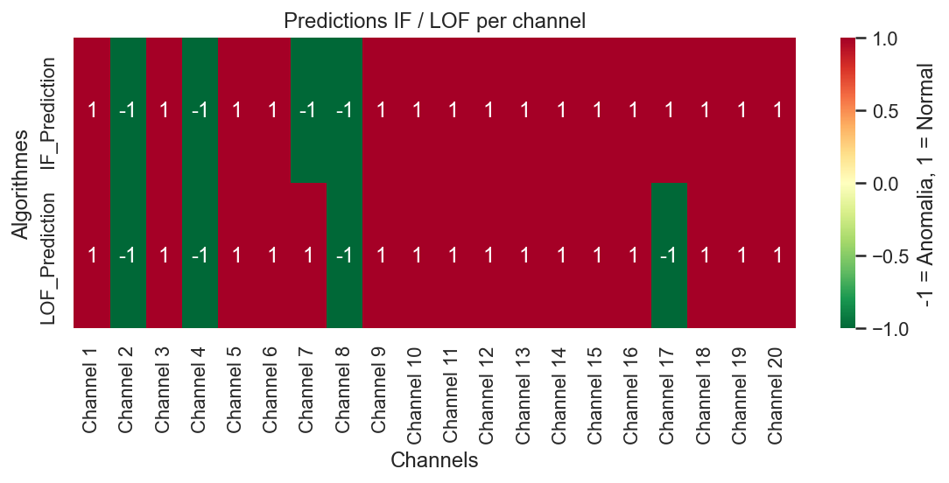

Slide 33
Thank you

